Slide 1


Slide 2
Instrumented Intelligence

Slide 3
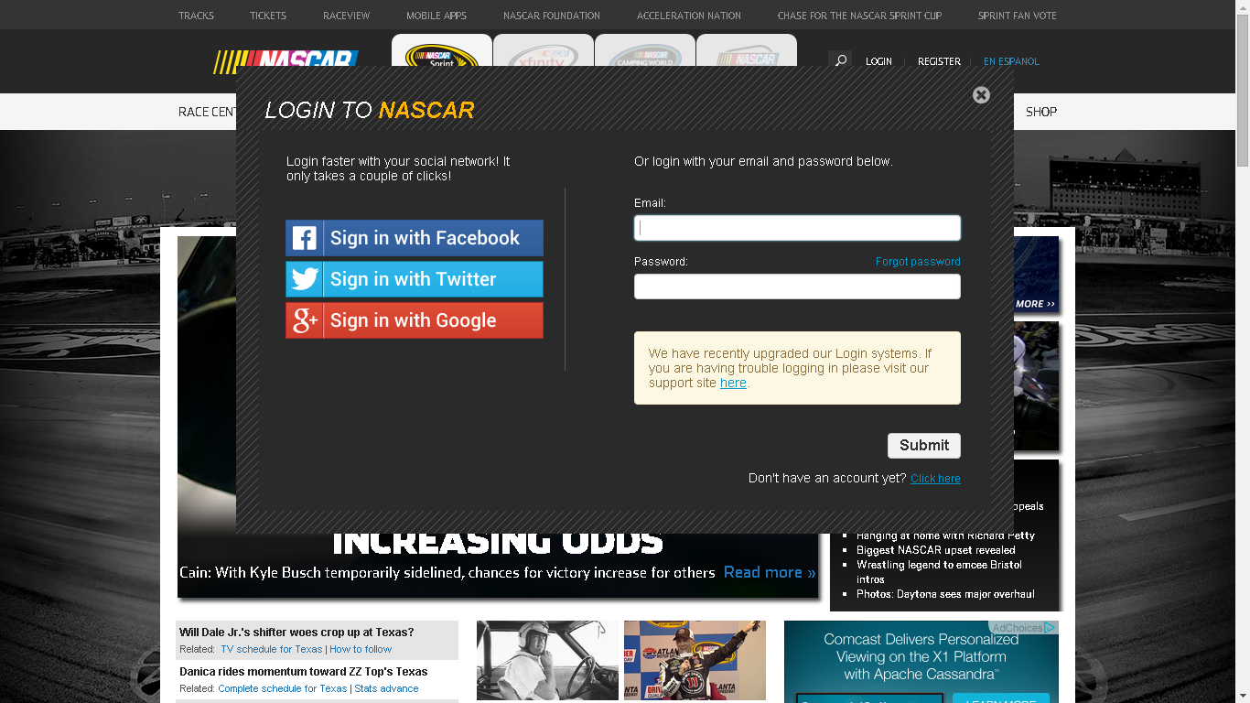
2013
Notes:
It was 2013 and I had just completed authentication & authorization system for NASCAR.com and it’s partner sites. A custom OpenID server implementation backed up Redis & LDAP that supports over 2 million hits in a hour; I thought this will the most satisfying piece of work that I will ever do in my life. I was so wrong.

Slide 4


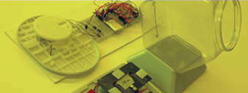
A new project!
Instrumented Intelligence listens to:
PEOPLE
Personal & wearable devices provide data on interactions, durations of visits, and interactions with objects.
PLACES
Places tell us how many visited, how long they stayed, what they touched, what they avoided, and what paths were taken.
THINGS
Things can tell us where they went, how fast they got there, whether they were used or not used, and what other products were used at the same time.
© COPYRIGHT 2015 SAPIENT CORPORATION | CONFIDENTIAL
Notes:
So, I walked up to my supervisor and said that I think I have reached a saturation point while building transactional systems and want to do something different. Perhaps something in analytics domain? He was like sure, why don’t you work with our new instrumented intelligence team?
The world is speaking, instrumented intelligence is listening through instrumented people, places and things to uncover micro and macro patterns of customer experience.

Slide 5

Example - Instrumenting a thing
© COPYRIGHT 2015 SAPIENT CORPORATION | CONFIDENTIAL
© COPYRIGHT 2015 SAPIENT CORPORATION | CONFIDENTIAL
Notes:
I was presented a demo of listening to a product for its usage pattern.

Slide 6
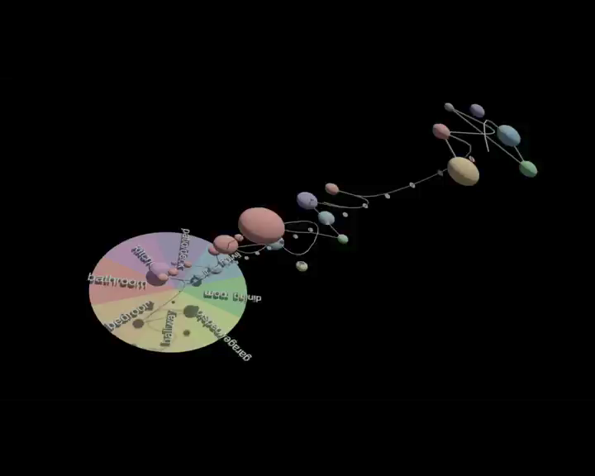
Example – Delivering Insights
© COPYRIGHT 2015 SAPIENT CORPORATION | CONFIDENTIAL
Notes:
We analyzed the “journeys” consumers took while using the product and it turned out that most people used to hide the product in a kitchen shelf instead of keeping it in a easily reachable place. When interviewed, consumers told us that they found the product “ugly” and hence spoils look of their home.
The other insight was that sometimes the spray didn’t work at an inclined angle.

Slide 7
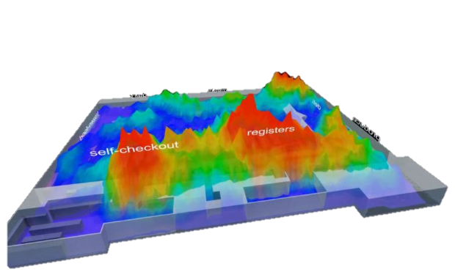
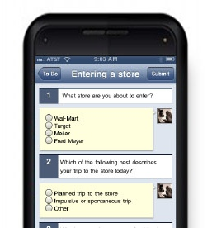

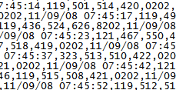
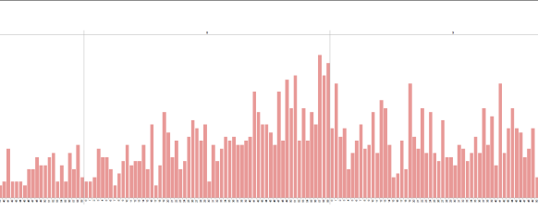
Data platform functional areas
Sense
Store
Analyze
Visualize
Instruments deployment
“Anchored” to people, places, and things
Store + information extraction
Structured and unstructured data
Machine learning
Statistics
Visualizations
Story telling
© COPYRIGHT 2015 SAPIENT CORPORATION | CONFIDENTIAL
Notes:
In the absence of well defined requirements, I broke the platform into the following areas

Slide 8




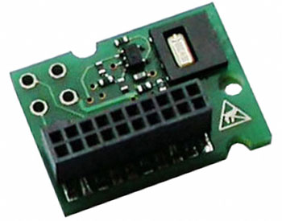
Channels API – Version 1
{
"id": "MyDevChannelDef",
"description": "Development channel",
"fields": [
{
"name": "MyField",
"typeId": "String",
"isKey": false
},
{
"name": "MyField2",
"typeId": "String",
"isKey": false
},
{
"name": "MyField3",
"typeId": "String",
"isKey": false
},
{
"name": "MyField4",
"typeId": "Long",
"isKey": false
},
{
"name": "MyField5",
"typeId": "Double",
"isKey": true
},
{
"name": "timestamp",
"typeId": "Timestamp",
"isKey": false
}
],
"metrics": [],
"config": {},
"version": 3
}
Sense
Store
Analyze
Visualize
Connector
Query API
Persist API
Storage
Batch Analytics
Reports
Channel Definition
Developer
Data
© COPYRIGHT 2015 SAPIENT CORPORATION | CONFIDENTIAL

Slide 9
Hbase – Columnar DB
Column Family 1
Column Family 2
Row Key | Col_Qual1 | Col_Qual2 | Col_Qual3 | Col_Qual4 | Col_Qual5 | Col_Qual1 | Col_Qual2 | Col_Qual3 | Col_Qual4 | Col_Qual5
row1
row10
row2
row3
row4
row5
row6
row7
row8
row9
© COPYRIGHT 2015 SAPIENT CORPORATION | CONFIDENTIAL

Slide 10
Hbase – Columnar DB
Column Family 2
Column Family 1
Column Family 2
Row Key | Col_Qual1 | Col_Qual2 | Col_Qual3 | Col_Qual4 | Col_Qual5 | Col_Qual1 | Col_Qual2 | Col_Qual3 | Col_Qual4 | Col_Qual5
row1
row10
row2
row3
row4
row5
row6
row7
row8
row9
© COPYRIGHT 2015 SAPIENT CORPORATION | CONFIDENTIAL

Slide 11
Hbase – Columnar DB
Column Family 1
Column Family 2
 | Col_Qual1 | Col_Qual2 | Col_Qual3 | Col_Qual4 | Col_Qual5 | Col_Qual1 | Col_Qual2 | Col_Qual3 | Col_Qual4 | Col_Qual5
row1
row10
row2
row3
row4
row5
row6
row7
row8
row9
© COPYRIGHT 2015 SAPIENT CORPORATION | CONFIDENTIAL

Slide 12
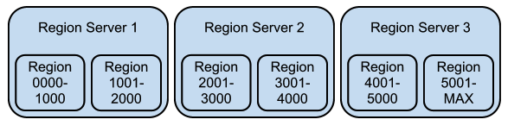
Hbase – Columnar DB
Courtesy - http://kiji.org/simplifying-hbase-schema-development-with-kijischema-eliminating-hotspots/
© COPYRIGHT 2015 SAPIENT CORPORATION | CONFIDENTIAL

Slide 13
Hbase – Designing Schema
Avoid hotspotting
Row keys should be as small as possible
Avoid using too many column families
© COPYRIGHT 2015 SAPIENT CORPORATION | CONFIDENTIAL

Slide 14
Channels API – Hbase Schema 1
id + timestamp | data
 | Serialized channel data
testId + 1407859200000 | data
 | Serialized channel data
testId + 1407859200001 | data
 | Serialized channel data
…
© COPYRIGHT 2015 SAPIENT CORPORATION | CONFIDENTIAL

Slide 15
Channels API – Hbase Schema Final
Hash(id + day)+boxed(id)+bucketed(timestamp) | timestamp -bucketed(timestamp)
 | Serialized channel data
For ID = “testID” and bucket size is 60000 & box size of 10:
Hash(testId + 12) + testId0000 + 1407859200000 | 00000 | 00001 | …
 | Serialized channel data | Serialized channel data | …
© COPYRIGHT 2015 SAPIENT CORPORATION | CONFIDENTIAL

Slide 16
Hbase Schema - Example
Column Family “data”
 | 00000 | 00001 | 00002 | 00003 | 00004
Hash(testId + 12) + testId + 1407859200000 | Channel Data |  |  |  | Channel Data
Hash(testId + 12) + testId + 1407859260000 |  |  | Channel Data
Hash(testId + 12) + testId + 1407859320000 |  | Channel Data
Hash(testId + 12) + testId + 1407859380000
Hash(testId + 12) + testId + 1407859440000 | Channel Data
Hash(testId + 12) + testId + 1407859500000 |  |  |  | Channel Data
Hash(testId + 12) + testId + 1407859560000 |  |  | Channel Data
1407859200004

Slide 17
Hbase Schema - Example
Fetch data from 1407859200000 to 1407859380000
Column Family “data”
 | 00000 | 00001 | 00002 | 00003 | 00004
Hash(testId + 12) + testId + 1407859200000 | Channel Data |  |  |  | Channel Data
Hash(testId + 12) + testId + 1407859260000 |  |  | Channel Data
Hash(testId + 12) + testId + 1407859320000 |  | Channel Data
Hash(testId + 12) + testId + 1407859380000
Hash(testId + 12) + testId + 1407859440000 | Channel Data
Hash(testId + 12) + testId + 1407859500000 |  |  |  | Channel Data
Hash(testId + 12) + testId + 1407859560000 |  |  | Channel Data

Slide 18


API Implementation
Non blocking
Sacrifice latency for throughout
Reactive uploads & downloads using Play! Iteratee and Enumerator
AsyncHBase
© COPYRIGHT 2015 SAPIENT CORPORATION | CONFIDENTIAL

Slide 19
Channels API – Hadoop Connector
For reading data:
Create HBase scanners as per the row key strategy
Use HBase’s TableMapReduceUtil.initTableMapperJob
For writing data:
Create HBase Put instances as per row key strategy
Use HBase’s TableMapReduceUtil.initTableReducerJob
© COPYRIGHT 2015 SAPIENT CORPORATION | CONFIDENTIAL

Slide 20
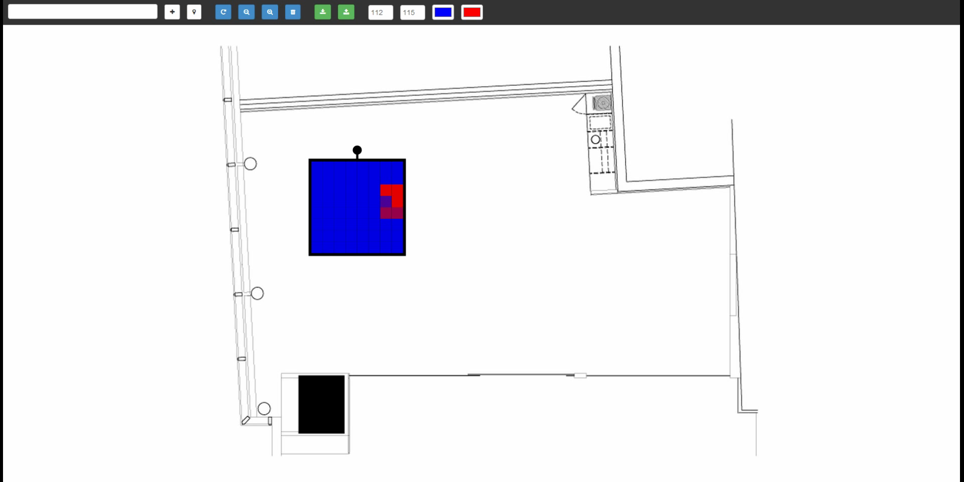
Channels API – New Requirement
Real time streaming to test deployments
© COPYRIGHT 2015 SAPIENT CORPORATION | CONFIDENTIAL

Slide 21

Channels API – Version 2
Sense
Store
Analyze
Visualize
Messaging
Connector
Query API
Persist API
Batch Analytics
Reports
Channel Definition
Developer
Storage
Data
Sanity Testing, build algorithms, etc
Analyst
© COPYRIGHT 2015 SAPIENT CORPORATION | CONFIDENTIAL

Slide 22

streaming Implementation
Persist
Publish(id,data)
Hash(id)
Streaming
subscribe(id)
rediscala
© COPYRIGHT 2015 SAPIENT CORPORATION | CONFIDENTIAL

Slide 23
Channels API – Version 2
Sense
Store
Analyze
Visualize
Messaging
Connector
Query API
Persist API
Batch Analytics
Reports
Channel Definition
Developer
Storage
Data
Sanity Testing, build algorithms, etc
Analyst
© COPYRIGHT 2015 SAPIENT CORPORATION | CONFIDENTIAL

Slide 24
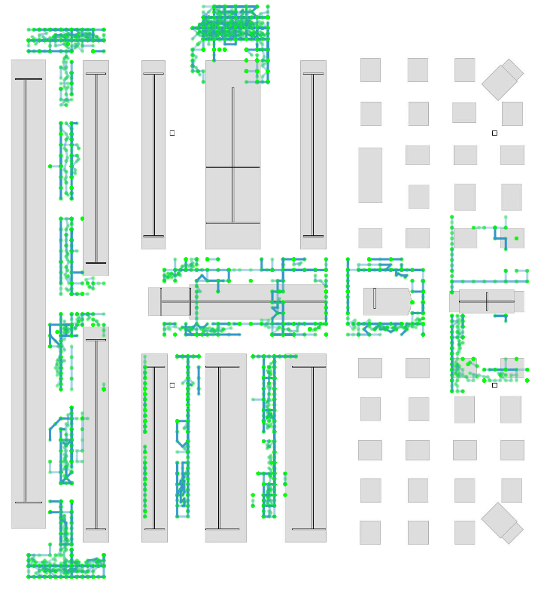
Sample analytics output
© COPYRIGHT 2015 SAPIENT CORPORATION | CONFIDENTIAL

Slide 25
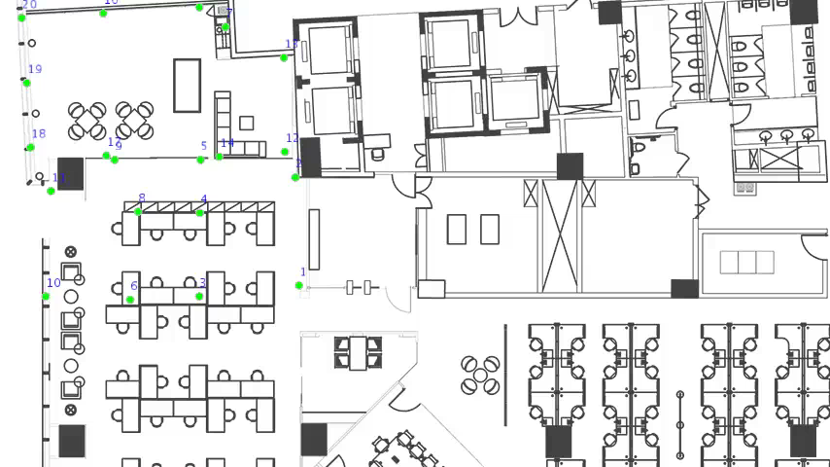
Channels API – New Requirement
Real time analytics
© COPYRIGHT 2015 SAPIENT CORPORATION | CONFIDENTIAL

Slide 26
High level Approach
Persistent Buffer
?
?
Real time analytics
Database
Persist API
Same Algorithm
Database
Batch Analytics
© COPYRIGHT 2015 SAPIENT CORPORATION | CONFIDENTIAL

Slide 27
Analytics Engine
Real time
Reuse
High level constructs
Reuse
Batch mode
© COPYRIGHT 2015 SAPIENT CORPORATION | CONFIDENTIAL

Slide 28

Analytics Engine
High level constructs
Cluster
Analyst Local machine
© COPYRIGHT 2015 SAPIENT CORPORATION | CONFIDENTIAL

Slide 29

Channels API – Version 3
Sense
Store
Analyze
Visualize
Real time Analytics
Channel Definition
Messaging
Developer
Persist API
Channels Spark Connector
Query API
Reports
Data
Batch Analytics
Storage
Sensor
Channels Spark Connector
Sanity Testing, build algorithms, etc
Analyst
© COPYRIGHT 2015 SAPIENT CORPORATION | CONFIDENTIAL

Slide 30
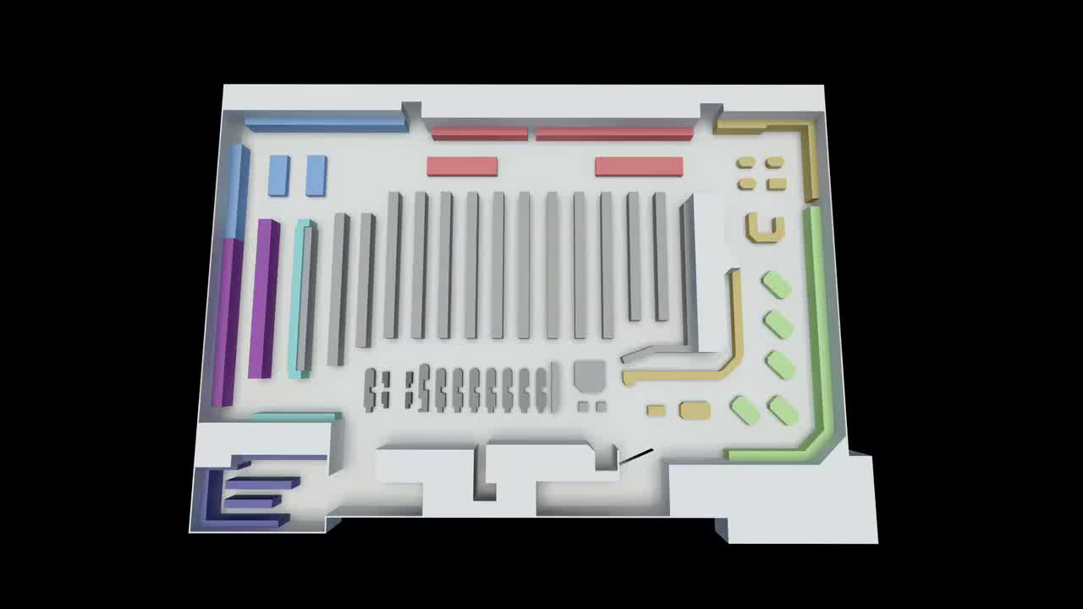
Sample analytics output
© COPYRIGHT 2015 SAPIENT CORPORATION | CONFIDENTIAL

Slide 31
Thank you! @RookieAniket

Slide 32
Appendix

Slide 33
Starship Data platform
Sense
Store
Analyze
Visualize
© COPYRIGHT 2015 SAPIENT CORPORATION | CONFIDENTIAL

